Slide 1
Parent Information Night
How to attain the IB Diploma

Slide 2
City’s Programs
Middle Years Programme
  Grades 7-10
  Framework not a curriculum
  Promotes-
    Focus on skills rather than content
    Inquiry based learning
    Use of rubrics
Diploma Programme
  Grades 11-12
  Prescribed curriculum

Slide 3
The Diploma Programme

Slide 4
Diploma Programme
The Diploma Programme is a challenging two-year pre-university curriculum. It leads to a qualification that is widely recognized by the world’s leading universities.
The Diploma Programme prepares students for university and encourages them to:
  ask challenging questions
  learn how to learn
  develop a strong sense of their own identity and culture
  develop the ability to communicate with and understand people from other countries and cultures.

Slide 5
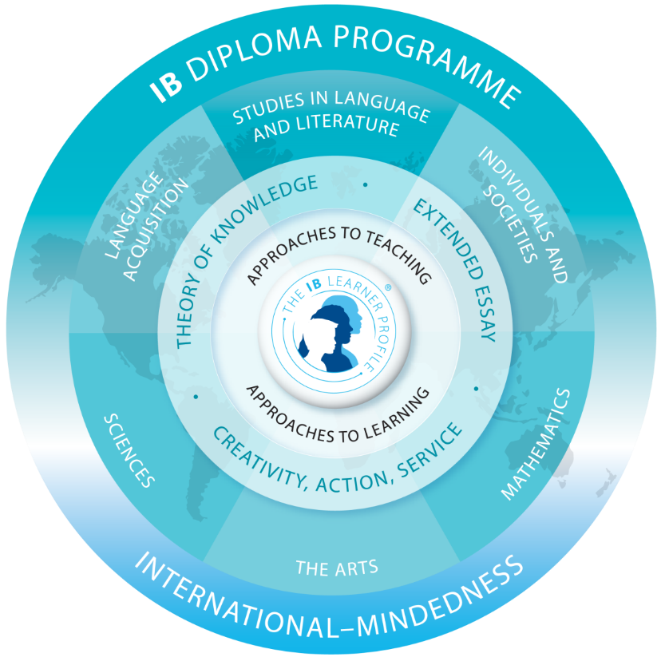
The curriculum contains six subject groups together with the DP core: creativity, activity, service (CAS); the extended essay (EE); and theory of knowledge (TOK).
This is illustrated by the below Diploma Programme model.

Slide 6
10 Reasons why the IB DP is ideal preparation for university
1) It offers academic breadth and depth
  IB graduates are much more likely to be accepted at the top post-secondary institutions based on exposure
2) Graduates care about more than just results
  CAS encourages experiential learning and develop skills beyond the classroom
3) It creates independent learners who feel prepared who feel prepared
  IB students complete the independent research for the EE and are analytical thinkers

Slide 7
10 Reasons why the IB DP is ideal preparation for university
4) It’s a genuinely international qualification
  Students learn to see the world from different cultural perspectives and strive to become internationally minded
5) Universities recognize it- and give credit for it
  The number of higher education institutions that recognize the DP continues to grow.
6) The IB encourages critical thinking
  Students learn to look beyond the facts to analyze sources and link subject matter across curriculums
7) You’ll never need to learn time management
  These skills continue on with students after being Diploma Programme students

Slide 8
10 Reasons why the IB DP is ideal preparation for university
8) It assesses more than examination techniques
  Focuses on what students have learned, but more importantly the skills they have acquired
9) Subjects aren’t taught in isolation
  Classes encourage students to make connections between the subject matter and transfer skills
10) Learner Profile attributes
  10 qualities that connect all IB programs to develop well-rounded, global minded learners

Slide 9
The Program Structure
How the program supports students in learning the skills that prepare them for university

Slide 10
The Diploma Programme Courses
Specialization is encouraged in the Diploma Programme by expecting students to study:
three (with the possibility of studying four) subjects at a higher level (HL).
This is balanced with a requirement for breadth by expecting students to study:
three more subjects at standard level (SL) (or two when four HL subjects are completed).

Slide 11
Higher Level vs. Standard Level
Seat time requirements
  240 vs. 150
Topics studied
  English- Number of novels
  Sciences- Topic Choices
Exam requirements
  Testing lengths
  Number of questions
Everything goes back to the difference of depth and breadth of the courses

Slide 12
Choosing Subjects
Students must take a class from each of the groups 1-5.
  Group 1: English Literature
  Group 2: Spanish, French or Mandarin Chinese
  Group 3: History
  Group 4: Chemistry, Physics, Biology, or Environmental Systems and Societies SL
  Group 5: Math HL, Math SL, Math Studies SL
A sixth subject may be selected from group 6 or from groups 1-5.
  Group 3: Psychology
  Group 6: Visual Arts or Music

Slide 13
Choosing Subjects
Students make subject selections during their 10th grade year.
Some subjects are offered based on interest, so it is important to understand that not all subjects will run every school year.
Students will rank their selections, so that they may be placed in alternative courses if necessary.
Students should understand, that they are selecting their classes for a two year period.

Slide 14
Scoring
All IB core classes are scored 1-7. These scores are based on the data from the internal and external assessments.
  Internal Assessments- completed at the school, graded by the teachers, and moderated by external examiners
  External Assessments- completed at the school and sent off to external examiners around the world to grade
All classes have a unique grade weight distribution

Slide 15
Grade Distribution Example
History of the Americas HL | External Assessments Paper 1: Four short-answer/structured questions Paper 2: Two extended-response questions Paper 3: Three extended-response questions | 80% 20% 25% 35%
 | Internal Assessments Historical Investigation | 20%
History of the Americas SL | External Assessments Paper 1: Four short-answer/structured questions Paper 2: Two extended-response questions | 75% 30% 45%
 | Internal Assessments Historical Investigation | 25%

Slide 16
The Core Requirements
Theory of Knowledge
Extended Essay
Creativity, Activity, Service

Slide 17
TOK/EE Matrix
 |  | Theory of Knowledge
 |  | Grade A | Grade B | Grade C | Grade D | Grade E | No Grade N
Extended essay | Grade A | 3 | 3 | 2 | 2 | Failing Condition | Failing Condition
 | Grade B | 3 | 2 | 2 | 1 | Failing Condition | Failing Condition
 | Grade C | 2 | 2 | 1 | 0 | Failing Condition | Failing Condition
 | Grade D | 2 | 1 | 0 | 0 | Failing Condition | Failing Condition
 | Grade E | Failing Condition | Failing Condition | Failing Condition | Failing Condition | Failing Condition | Failing Condition
 | No Grade N | Failing Condition | Failing Condition | Failing Condition | Failing Condition | Failing Condition | Failing Condition

Slide 18
Creativity, Activity, Service
CAS is designed to strengthen and extend students’ personal and interpersonal learning.
CAS enables students to demonstrate the attributes of the Learner Profile
Students maintain a CAS portfolio (which is housed in their 8th hour classes), complete a CAS project and complete 8-10 hours each month
  CAS Project-a collaborative series of CAS experiences that benefit a community.
    Creativity- student group plans, designs and creates a mural
    Activity- students organize and maintain a sports club
    Service- students set up and conduct a tutoring group

Slide 19
The Diploma
Putting it all together

Slide 20
All the parts to make the whole
Students take 6 classes
  Each class receives a score of 1-7
    6x7=42 points possible
    Goal for students is to get at least a 4 in each class
TOK/EE and CAS
  Receive grades A-E
  Applied to the matrix to earn points 0-3
  Points are added to class scores
  CAS has been completed
Points
  Most points that can be earned 45
  Fewest points that can be earned 24 (must fit Article 13 requirements-page 14).

Slide 21
Award of the IB Diploma
The IB diploma is awarded based on performance across all parts of the DP.
Each subject is graded 1–7, with 7 being the highest grade.
These grades are also used as points (that is, 7 points for a grade 7, 6 points for a grade 6, and so on) in determining if the diploma can be awarded.
TOK and the EE are graded A–E, with A being the highest grade. These two grades are then combined in the diploma points matrix to contribute between 0 and 3 points to the total.
CAS is not assessed but must be completed in order to pass the diploma. See section A2.2.2.
The overall maximum points from subject grades, TOK and the EE is therefore 45: ((6 × 7) + 3).
The minimum threshold for the award of the diploma is 24 points. If a candidate scores less than 24 points, the diploma is not awarded.

Slide 22
Award of the IB Diploma
The additional requirements for the award of the diploma are as follows.
CAS requirements have been met.
There is no “N” awarded for TOK, the EE or for a contributing subject.
There is no grade E awarded for TOK and/or the EE.
There is no grade 1 awarded in a subject/level.
There are no more than two grade 2s awarded (SL or HL).
There are no more than three grade 3s or below awarded (HL or SL).
The candidate has gained 12 points or more on HL subjects. (For candidates who register for four HL subjects, the three highest grades count.)
The candidate has gained 9 points or more on SL subjects. (Candidates who register for two SL subjects must gain at least 5 points at SL.)
The candidate has not received a penalty for academic misconduct from the final award committee.

Slide 23
Examples
Grade Subject
5- ENGLISH A: Literature HL in ENGLISH
4- FRENCH AB. SL in FRENCH
4- HIST.AMERICAS HL in ENGLISH
3- BIOLOGY SL in ENGLISH
3- MATHEMATICS SL in ENGLISH
D- MUSIC EE in ENGLISH
4- MUSIC HL in ENGLISH
C- THEORY KNOWL. TK in ENGLISH
EE/TOK points: 0
Total Points: 23
Result: Diploma not awarded
Candidate earned fewer than 24 points
Grade Subject
4- ENGLISH A: Literature HL in ENGLISH
3- FRENCH AB. SL in FRENCH
4- HIST.AMERICAS HL in ENGLISH
B- HISTORY EE in ENGLISH
4- BIOLOGY SL in ENGLISH
3- MATHEMATICS SL in ENGLISH
4- VISUAL ARTS HL in ENGLISH
C- THEORY KNOWL. TK in ENGLISH
EE/TOK points: 2
Total Points: 24
Result: Diploma awarded

Slide 24
Examples
Grade Subject
4- ENGLISH A: Literature SL in ENGLISH
4- SPANISH B SL in SPANISH
4- HIST.AMERICAS HL in ENGLISH
3- BIOLOGY HL in ENGLISH
5- MATH STUDIES SL in ENGLISH
C- PEACE&CONFLICT ST EE in ENGLISH
4- PSYCHOLOGY HL in ENGLISH
C- THEORY KNOWL. TK in ENGLISH
EE/TOK points: 1
Total Points: 25
Results: Diploma not awarded
Candidate has gained fewer than 12 points on HL subjects
Grade Subject
4- ENGLISH A: Literature HL in ENGLISH
5- SPANISH B SL in SPANISH
4- HIST.AMERICAS HL in ENGLISH
3- BIOLOGY SL in ENGLISH
3- MATHEMATICS SL in ENGLISH
C- VISUAL ARTS EE in ENGLISH
4 - VISUAL ARTS OPTION A HL in ENGLISH
C- THEORY KNOWL. TK in ENGLISH
EE/TOK points: 1
Total Points: 24
Results: Diploma awarded

Slide 25
Results
IB results are released in the month of July following students’ senior year.
Students are able to request that IB scores are sent to a college of choice at no cost.
  If students do not report intended college of attendance by June 1 of senior year, the student will have to request scores on their own for a fee.
Students may request to have a predicted grades sheet completed for the schools they are applying to during their senior year, with the understanding the those scores are only a prediction and will not be accurate until after May examinations are taken.

Slide 26
City’s Growth
How our Diploma Programme has grown over the first four years

Slide 27
City’s Growth

Slide 28
City’s Growth- what changed?
Staff meeting and PD days focused on horizontal and vertical alignment
  Address MYP to DP transitional challenges
Ordering examiner feedback
    Critical for DP teachers to pinpoint gaps and important look fors
Building in within the master schedule
  Research Strategies- 8th hour focus on EE and CAS
Increased training for all staff
Refining the internal assessment calendar to help stagger the deadlines for students (and staff)
    Makes progression more manageable for students
Changed school schedule
  Increase teacher-student contact time and in turn strengthened positive teacher-student relationships

Slide 29
Making students successful
What can parents do to support their students success in the Diploma Programme?

Slide 30
Success in the Diploma Programme
Encourage students to
1) Pick subjects they are enthusiastic about.
-Math, Science, Group 6
2) Choose Higher Level and Standard Level Subjects wisely.
3)Learn the command terms and objectives for the subjects
-Using subject specific terminology will allow students to demonstrate their understanding.
4)Use time management
-Keep up with assignments

Slide 31
Success in the IB
5)Start the EE early and work on it incrementally
6)Take TOK seriously
7) Have a support system
-parents, friends, IB alum
8) Practice skills needed for examinations
-practice tests and questions are available for all subjects
9) Set aside “me” time

Slide 32
Questions?
In regards to the Diploma Programme, specifically diploma attainment, what questions do you have?

