Slide 1
Culminating Experiences
The Personal Project and The Extended Essay

Slide 2
Culminating Experiences across the IB Continuum
Primary Years Programme
The Exhibition
Middle Years Programme
The Personal Project
Diploma Programme
The Extended Essay

Slide 4
The Personal Project
An excellent opportunity for students to produce a truly personal and often creative product/outcome and to demonstrate a consolidation of their learning in the MYP.
The project offers many opportunities for differentiation of learning and expression according to students’ individual needs.
The personal nature of the project is important; the project should revolve around a challenge that motivates and interests the individual student.
Each student develops a personal project independently

Slide 5
Personal Project Supervisors
Students will all be scheduled into an EPIC IV class.
Each class will have a teacher overseeing their PP progress and facilitating their completion of the requirements.
Assign students a grade based on the MYP criterion for the Personal Project

Slide 6
More than just the Project
The personal journey is the main focus of The Personal Project. It is not just about what it created, as some students may fall short, but rather the learning experience along the way.
Other focuses-
Process Journal- documents the steps taken throughout the experience
Report
Presentation- Project Exhibition

Slide 7
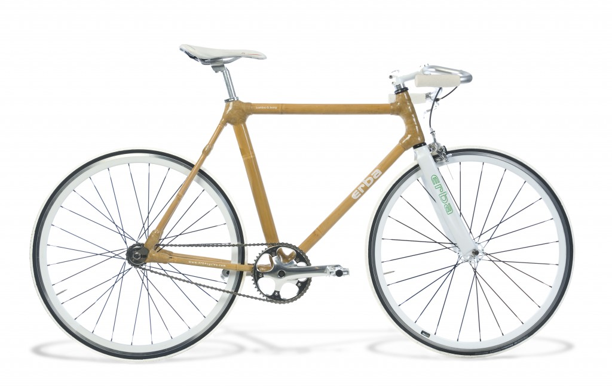
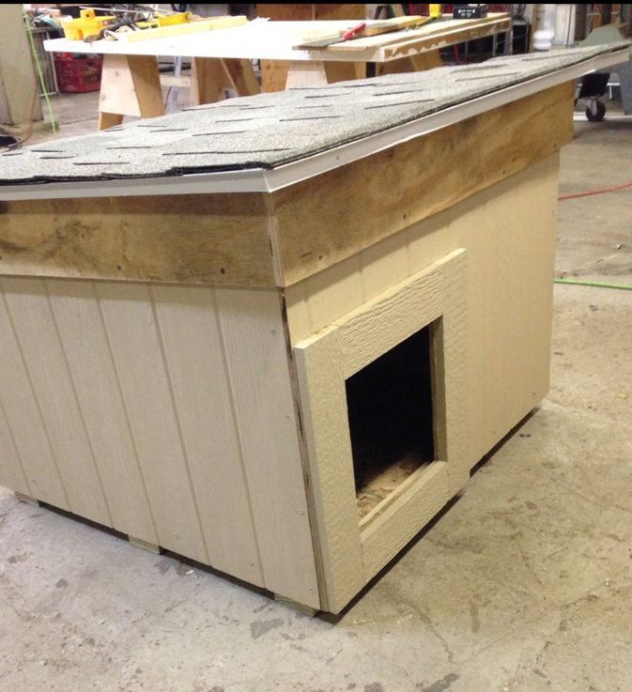
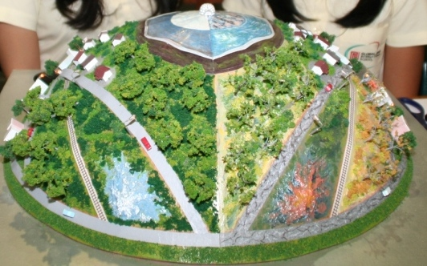
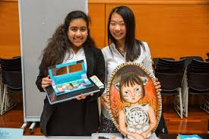

Slide 8
Personal Project Report
Final Report Requirements
Signed Academic Honesty Sheet
Title Page including title, student name, school and date submitted
Table of Contents
1500-3500 words, NOT counting the Title Page, Works Cited page, or Appendices.
A section for each criterion with headings identifying Criterion A: Investigating, Criterion B: Planning, Criterion C: Taking Action, and Criterion D: Reflecting
Use of and in-text citations for a minimum of 10 sources within the essay
All citations must be in APA Sixth Edition format
Works Cited Page in APA Sixth Edition format

Slide 9
Personal Project Criterion
A. Investigating
Define and goal and global context, based on interest
Identify prior learning and subject specific knowledge
Research skills
B. Planning
Develop criteria for the product/outcome
Plan and record development process
Demonstrate self management skills
C. Taking Action
Create a product in response to the goal, global context and criteria
Demonstrate thinking skills
Demonstrate communication and social skills
D. Reflecting
Evaluate quality of product against criteria
Reflect on how the project has extended their knowledge and understanding
Reflect on development as an IB learner

Slide 10
Moderation
All Personal Project scores are submitted to IB
IB will request a sample of student reports that demonstrate scores in the top, middle and lower markbands.
This is the first year of Personal Project Moderation.

Slide 12
The Extended Essay
The extended essay is an independent, self-directed piece of research, culminating in a 2,800 to 4,000-word paper.
As a required component, it provides:
practical preparation for the kinds of undergraduate research
an opportunity for students to engage in an in-depth study of a topic of interest within a chosen subject.

Slide 13
Correlation
How is the Extended Essay related to the Personal Project?
Self directed research, in which students are accountable for their own success and failure
Need time management skills
Brings together skills learned throughout the programs.
While the personal project enables students to pursue their personal interests further in the MYP, the DP extended essay enables students to pursue an academic interest.

Slide 14
Topic Selection
Students are encouraged to choose a topic of interest, that focuses on one of the six subject areas that they are taking while in City’s Diploma Programme.
It has been found that students that are not passionate or genuinely interested in their topic choice, struggle with completing the EE.

Slide 15
Starting the EE
Students begin receiving mini lessons around the Extended Essay starting in the fall of their junior year.
Throughout the first semester, they work closely with their 8th hour teacher on understanding the essay, tips for writing the essay, and how to select a topic.

Slide 16
EE Mentors
Extended Essay Mentor Selection takes place during junior year.
Students work with mentors and 8th hour teachers throughout the rest of the EE process.
Mentors oversee the authenticity of the essay, provide advice and guidance, help students stay focused in their writing, and offer subject-specific supports.

Slide 17
Extended Essay Criterion
A. Focus and Method
Focus on the topic, research question and the methodology.
B. Knowledge and Understanding
Extent to which the research relates to the subject area/discipline used to explore the research question.
C. Critical Thinking
Extent to which critical- thinking skills have been used to analyze and evaluate the research undertaken.

Slide 18
Extended Essay Criterion
D. Presentation
Extent to which the presentation follows standard format expected for academic writing and effective communication.
E. Engagement
Assesses student engagement with their research focus and the research process.

Slide 19
Moderation
All Extended Essay Scores are submitted to IB
IB will request a sample of student reports that demonstrate scores in the top, middle and lower markbands.
Essays are registered within a subject area and samples will be requested from each subject area at the school.

